Slide 1
Google Data Analytics Capstone Project
Analysed by:
Arpit Goyal
( 3rd Year B. Tech )

Slide 2
Business Task
Use data analysis to find out the difference between the usage of Cyclistic’s bikes by Annual Members and Casual Riders.

Slide 3
Data Source
Data source provided in the Analytics Course:
https://divvy-tripdata.s3.amazonaws.com/index.html

Slide 4
Summary of The Cleaning Process of the Data:
Excel
Formatted each column with the appropriate format.
Removed rows where end_date was greater than the start_date.
Added columns named “day” which shows the day of the week and “ride_length” which shows the time between start and end time.
Applied filter to every column of the table for easy access of data.
Sorted the list by Type of Rider ( Casual or Member ).
Hid some un-necessary columns to increase efficiency.

Slide 5
Excel
Created some Pivot Tables to simplify the data further.
Pivot tables which shows the Count of riders grouped by the day of the week for members and casual riders.
Table which shows the average Ride time grouped by of the week for members and casual riders.
Table which shows the Maximum ride time grouped by day of the week for members and casual riders.
Used some graphics within the excel sheet to understand trends easily and in a graphical manner.

Slide 6
Sequel ( SQL )
Imported the data sheets into the BigQuery Database.
Used simple SQL clauses like Select, and From to get the desired table.
Used the WHERE clause to further clean the data and get the desired output.
Created new attributes to make the data more understandable.

Slide 7
Summary of The Data Analysis

Slide 8
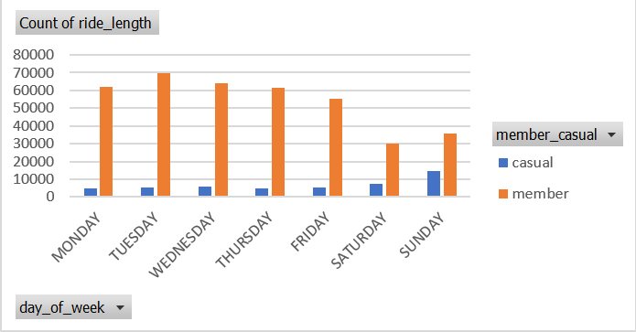
Finding 1
The number of member users is much more than the number of casual users per day.

Slide 9
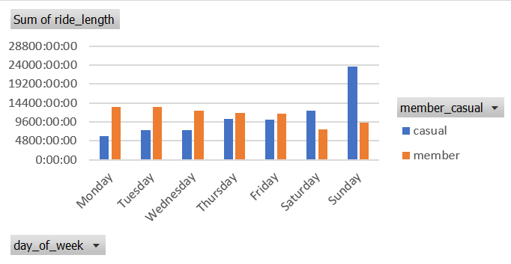
Finding 2
Sum of ride lengths for each day is almost similar in both cases, except on sundays.

Slide 10
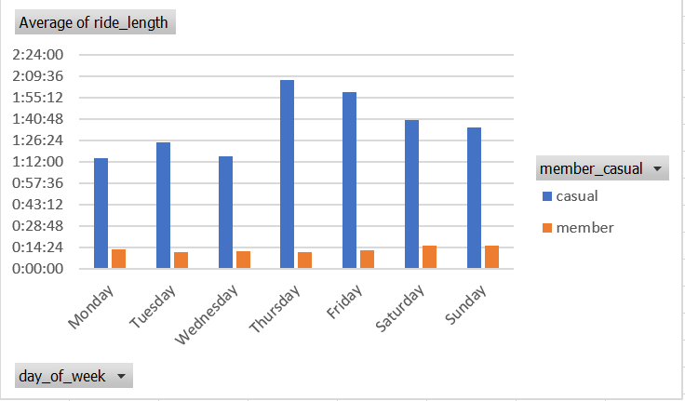
Finding 3
Average of ride length is much more for casual rider as compared to member riders.

Slide 11
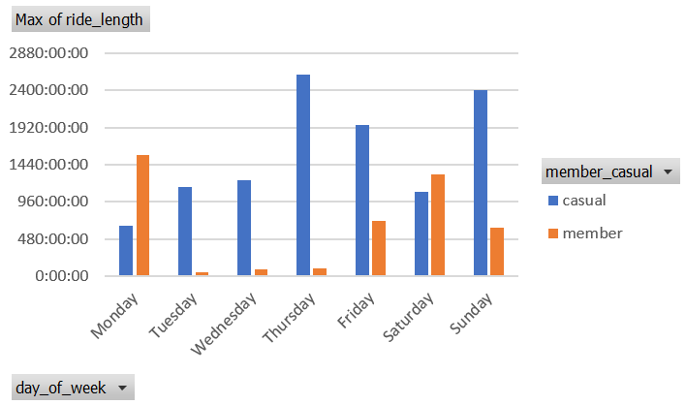
Finding 4
Casual riders hire the bikes for much longer compared to member riders.

Slide 12
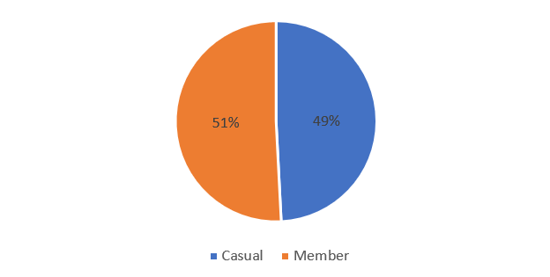
Percentage Share of Total Ride Lengths

